Slide 1


MIDWAY CITY SANITARY DISTRICT
Year-End Review Report 2025
January 2026

Slide 2











Services and Program Development
*Launched GoGov
CRM Platform &
Mobile App
*Presented 1st annual report
Rose Award
Transparency Award
Social Media Blue Check Mark
45,000+ Calls
Up 4,000 from 2024
5 Clean up events
1 Compost event
1 Open House
2 Shredding events
20+ Radio programs
8 City events
6,417 bulky items
Up 267 from 2024
1,488 metal items
Up 209 from 2024
4,419 mattresses and boxsprings collected and recycled
Up 584 from 2024

Slide 3


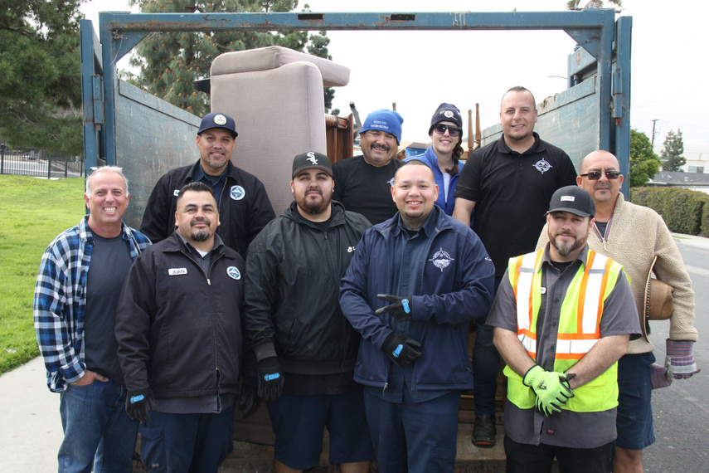
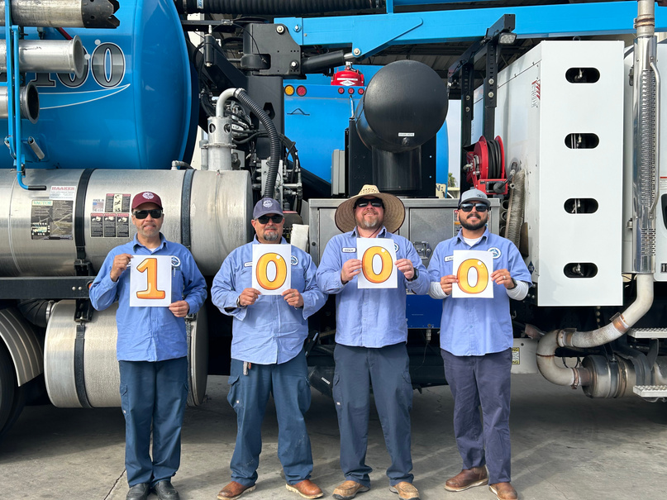
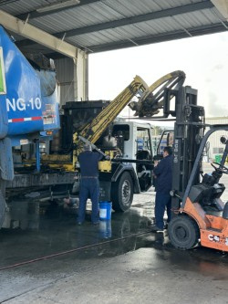

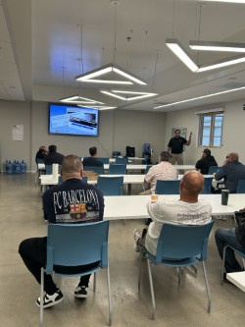
Operations
1000 + days without a SSO
5 Clean-up events
1 Compost event
2 shredding events
Savings through in-house fleet maintenance
4,419 mattresses and boxsprings collected and recycled
2 Driver’s training courses

Slide 4





Engineering
Sewer system master plan
Sewer system management plan
5-year capital and operations plan
Local hazard mitigation plan
Successful emergency repairs at Westpark Place
Permits
258
Up 35 from 2024
Pump, generator, and CNG maintenance
Preparations for large scale manhole project at Springdale and Westminster
Implementation of Sewer AI technology
Completion of fire suppression systems on solid waste trucks
Expanded the department with an engineering technician

Slide 5




Finance and Technology
Finance
IT
Successful audit
Successful preparation of 25-26 budget
Implementation of Positive Pay
Creation of first ever 5 - year IT capital and operations plan
Resolution of SCADA system issues
Preparation of cost recovery calculations
Completed GASB 75 OPEB Valuation
Partnered with Procure America to successfully renegotiate bank management fees
Installation of server capacity for CCTV data storage
Successful connection of WiFi to mechanics shop
Implementation of credit card processing
Successful submission of Parcel Levy Program
Evaluated and began upgrading lift station WiFi and connectivity
Awarded $250,000 Cyber Security Grant

Slide 6




Services and Program Development Goals/Projects
Acquire more land for expansion of work space, vehicle storage, lift stations, EV charging stations
Battery disposal campaign
Cart cleaning
New truck signs
Update logo
Website update
WISE agreement notifications
Open House
Annual Compost/ Shredding event
5 Clean up events
Pop-up shredding events
City events - Tet Parade, Safety Day, Fall Festival
Radio and PSA
School Assemblies
Career Day events at schools
SB1383 and FOG compliance and enforcement
In-house enforcement
JACE Audit completion
Electronic annual report
ADA compliance for website
Partnership with Townsend to secure grants and earmarks
Re-apply for CalRecycle grant

Slide 7




Operations Goals
Safety Excellence
Continue regular safety trainings, ensuring all employees are current on the latest safety protocols and procedures.
Target: 100% participation across all departments
Accident and Injury-Free Operations
Maintain a completely accident and injury-free workplace throughout 2026, protecting our most valuable asset-
Our People
ZERO SSOs
Achieve zero Sanitary Sewer Overflows, resulting from sewer maintenance operations through proactive maintenance and monitoring.
Continue building on the 1000 days that was achieved in 2025
Employee Morale and Engagement
Build upon existing monthly employee appreciation luncheons to further strengthen teamwork, recognition, and overall workplace morale

Slide 8

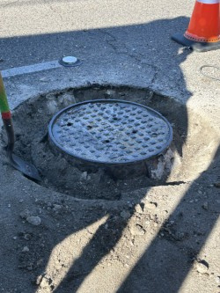
Future Projects
Cockroach Mitigation Project - Phase 3
Flow monitoring project
SCADA System security upgrades
Sewer System Rehabilitation projects
Manhole frame and cover replacement project
CNG evaluation and upgrades
Sewer Main Rehabilitation project - phase 2
Micro Grid project
Gravity Main Upsizing project
FOG inspections/enforcement
Engineering Goals
Current Projects
FOG program management and inspections
14th St sewer extension
7474 Garden Grove Blvd sewer relocation
Sewer Main Rehabilitation Project (Phase 1)
Manhole project at Springdale and Westminster
Updating sewer standards
Westminster Mall project and other City Development projects
Smart Cover installation at 5 manhole locations

Slide 9
Finance and Technology Goals
Finance
IT
On-Going: QuickBooks upgrade
On-Going: Pump/Lift station communications system upgrade (3 lift stations completed)
Establishment of ACH Preferred Vendor payment capability
CSMFO Budget Award Submission FY 2026/2027
Implementation of construction permit work-flow system in QuickBooks
Development of Investment Strategic Plan
Consideration of acquisition and roll-out of desk top UPS systems for District computers
Commission of Phishing testing and training for staff for Cybersecurity management
Completion of pump/lift station communication upgrades
Interface connection within QuickBooks with 3rd party vendors
Group Life Insurance Analysis and Presentation
GASB 75 Health Care Program presentation
BRING BACK RECESS!

Slide 10

Thank You for an Amazing Year

